Slide 1

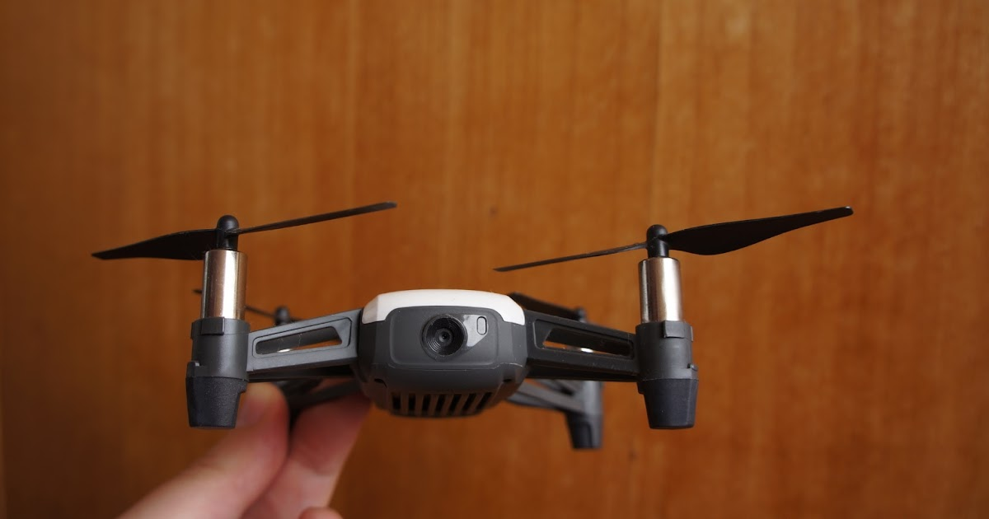
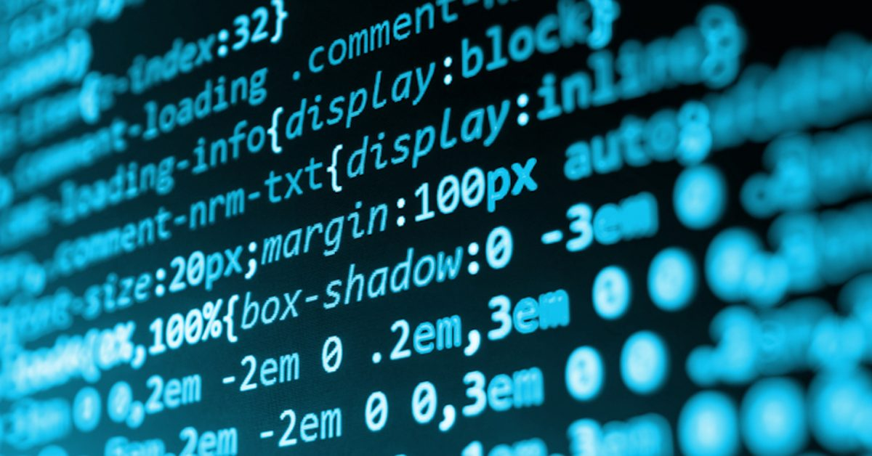
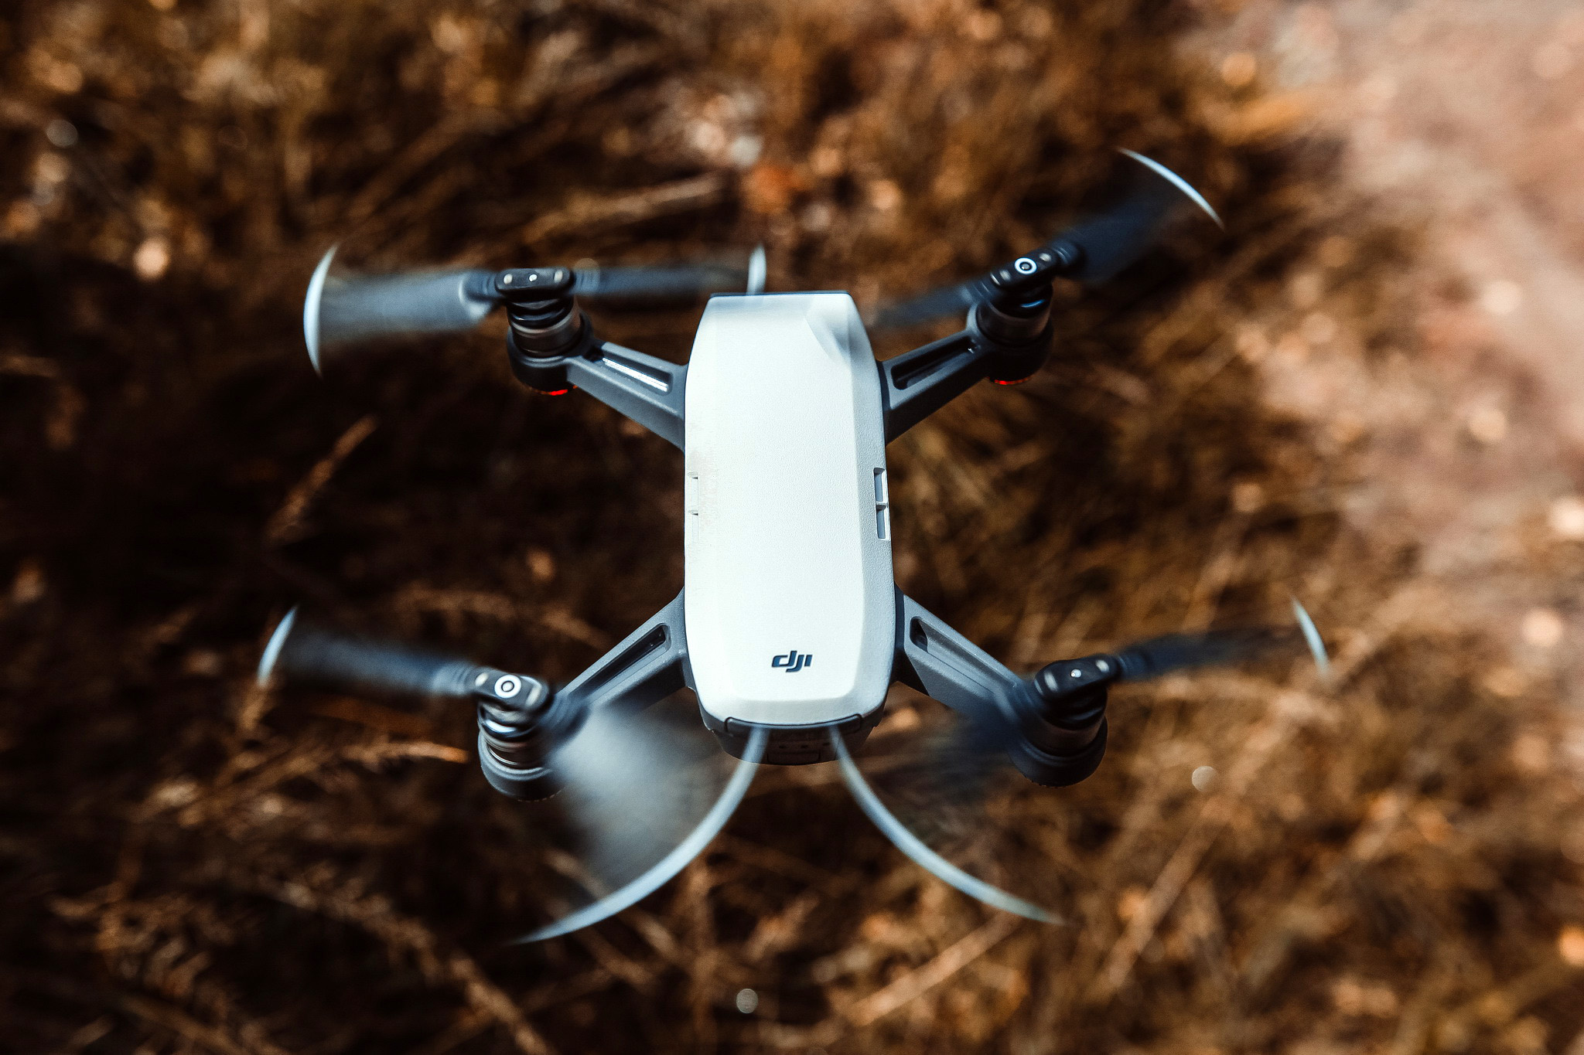
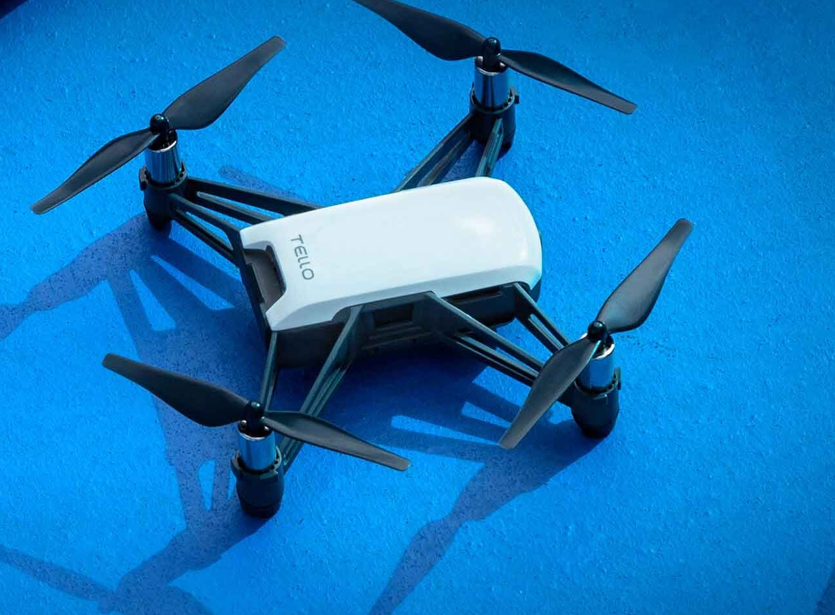
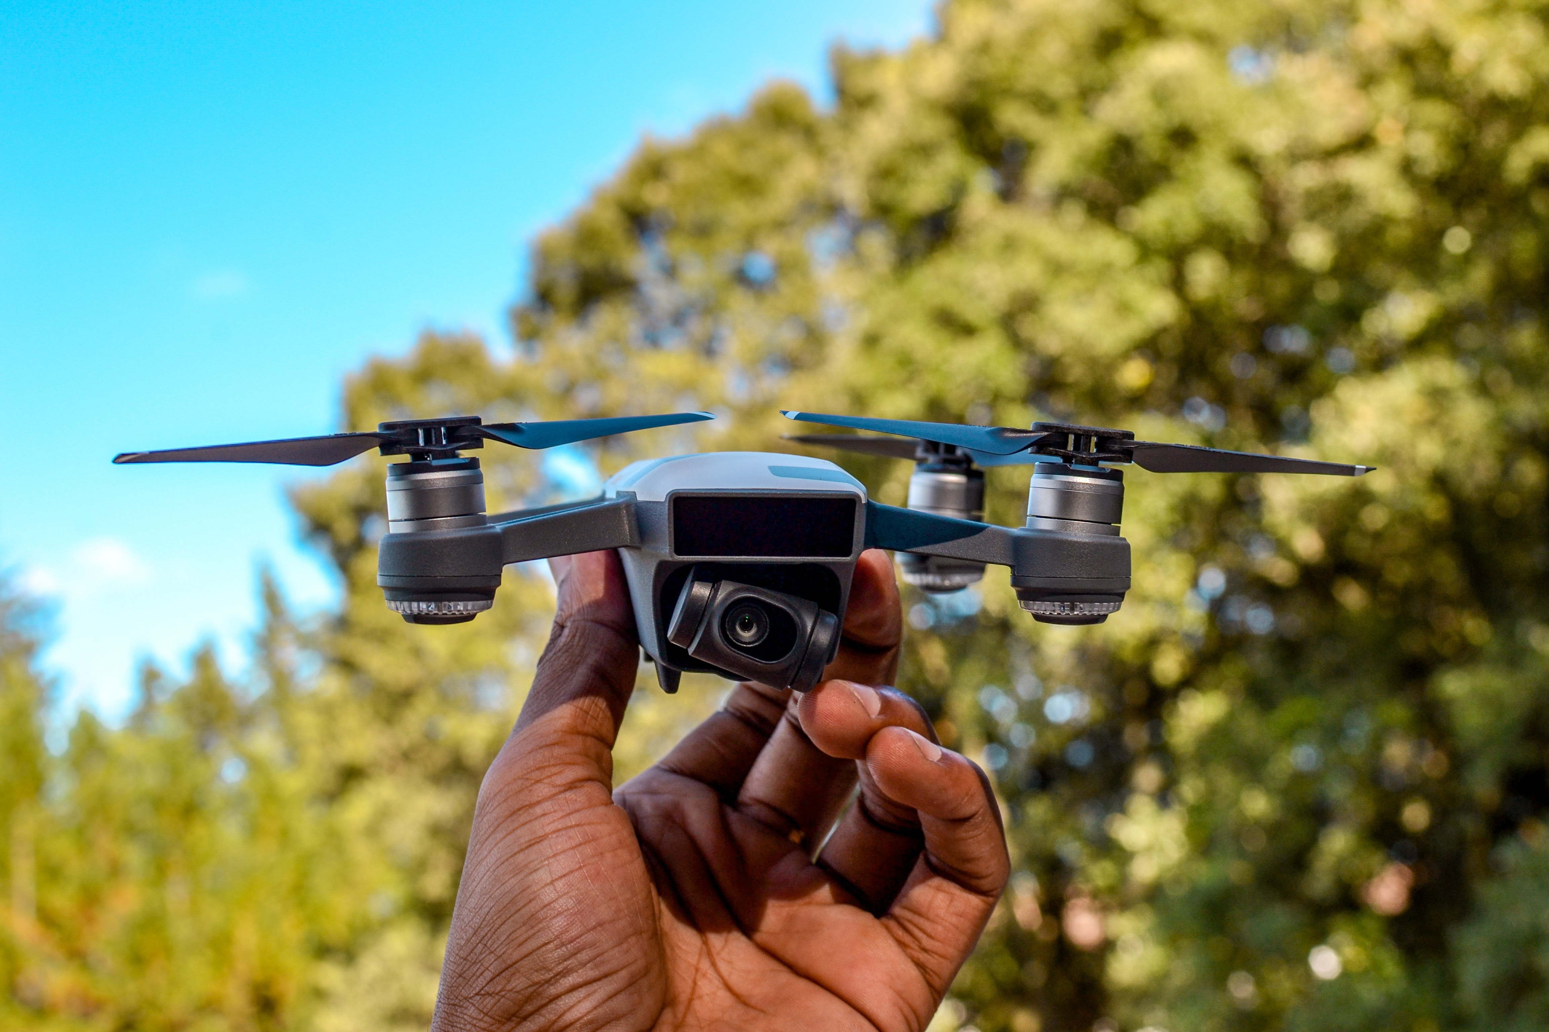
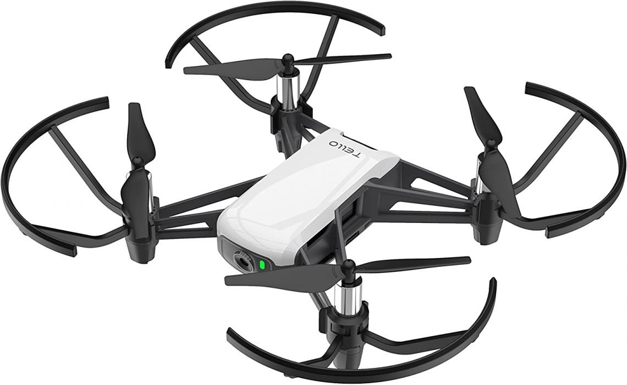
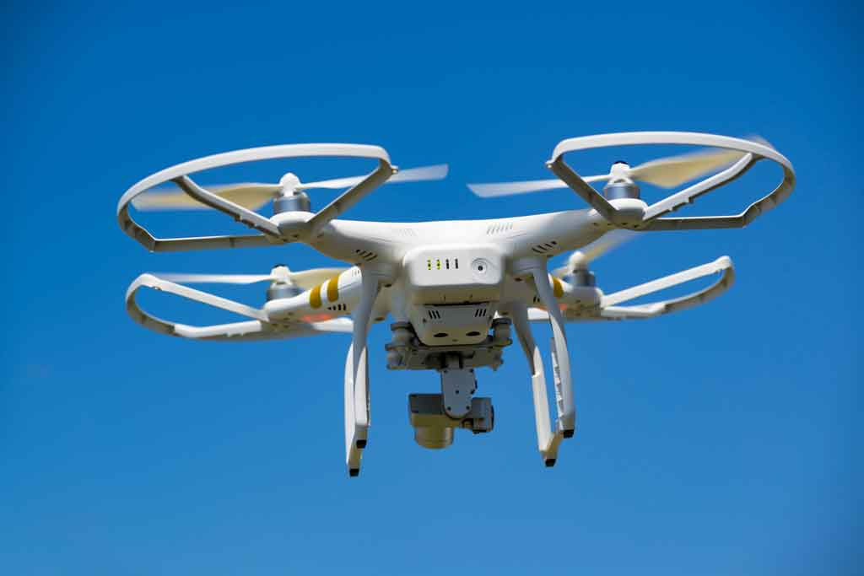
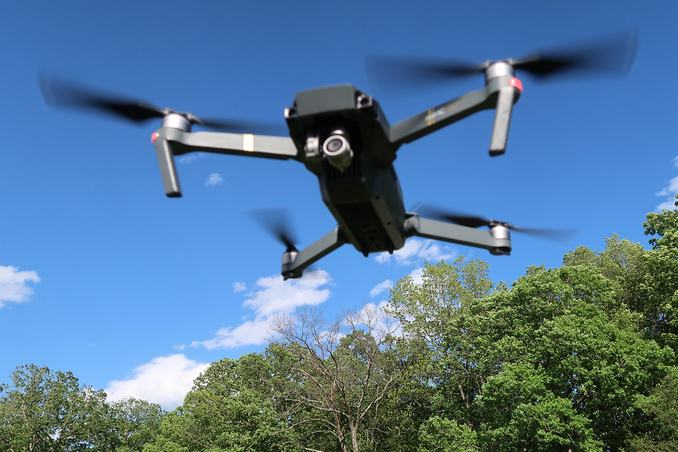

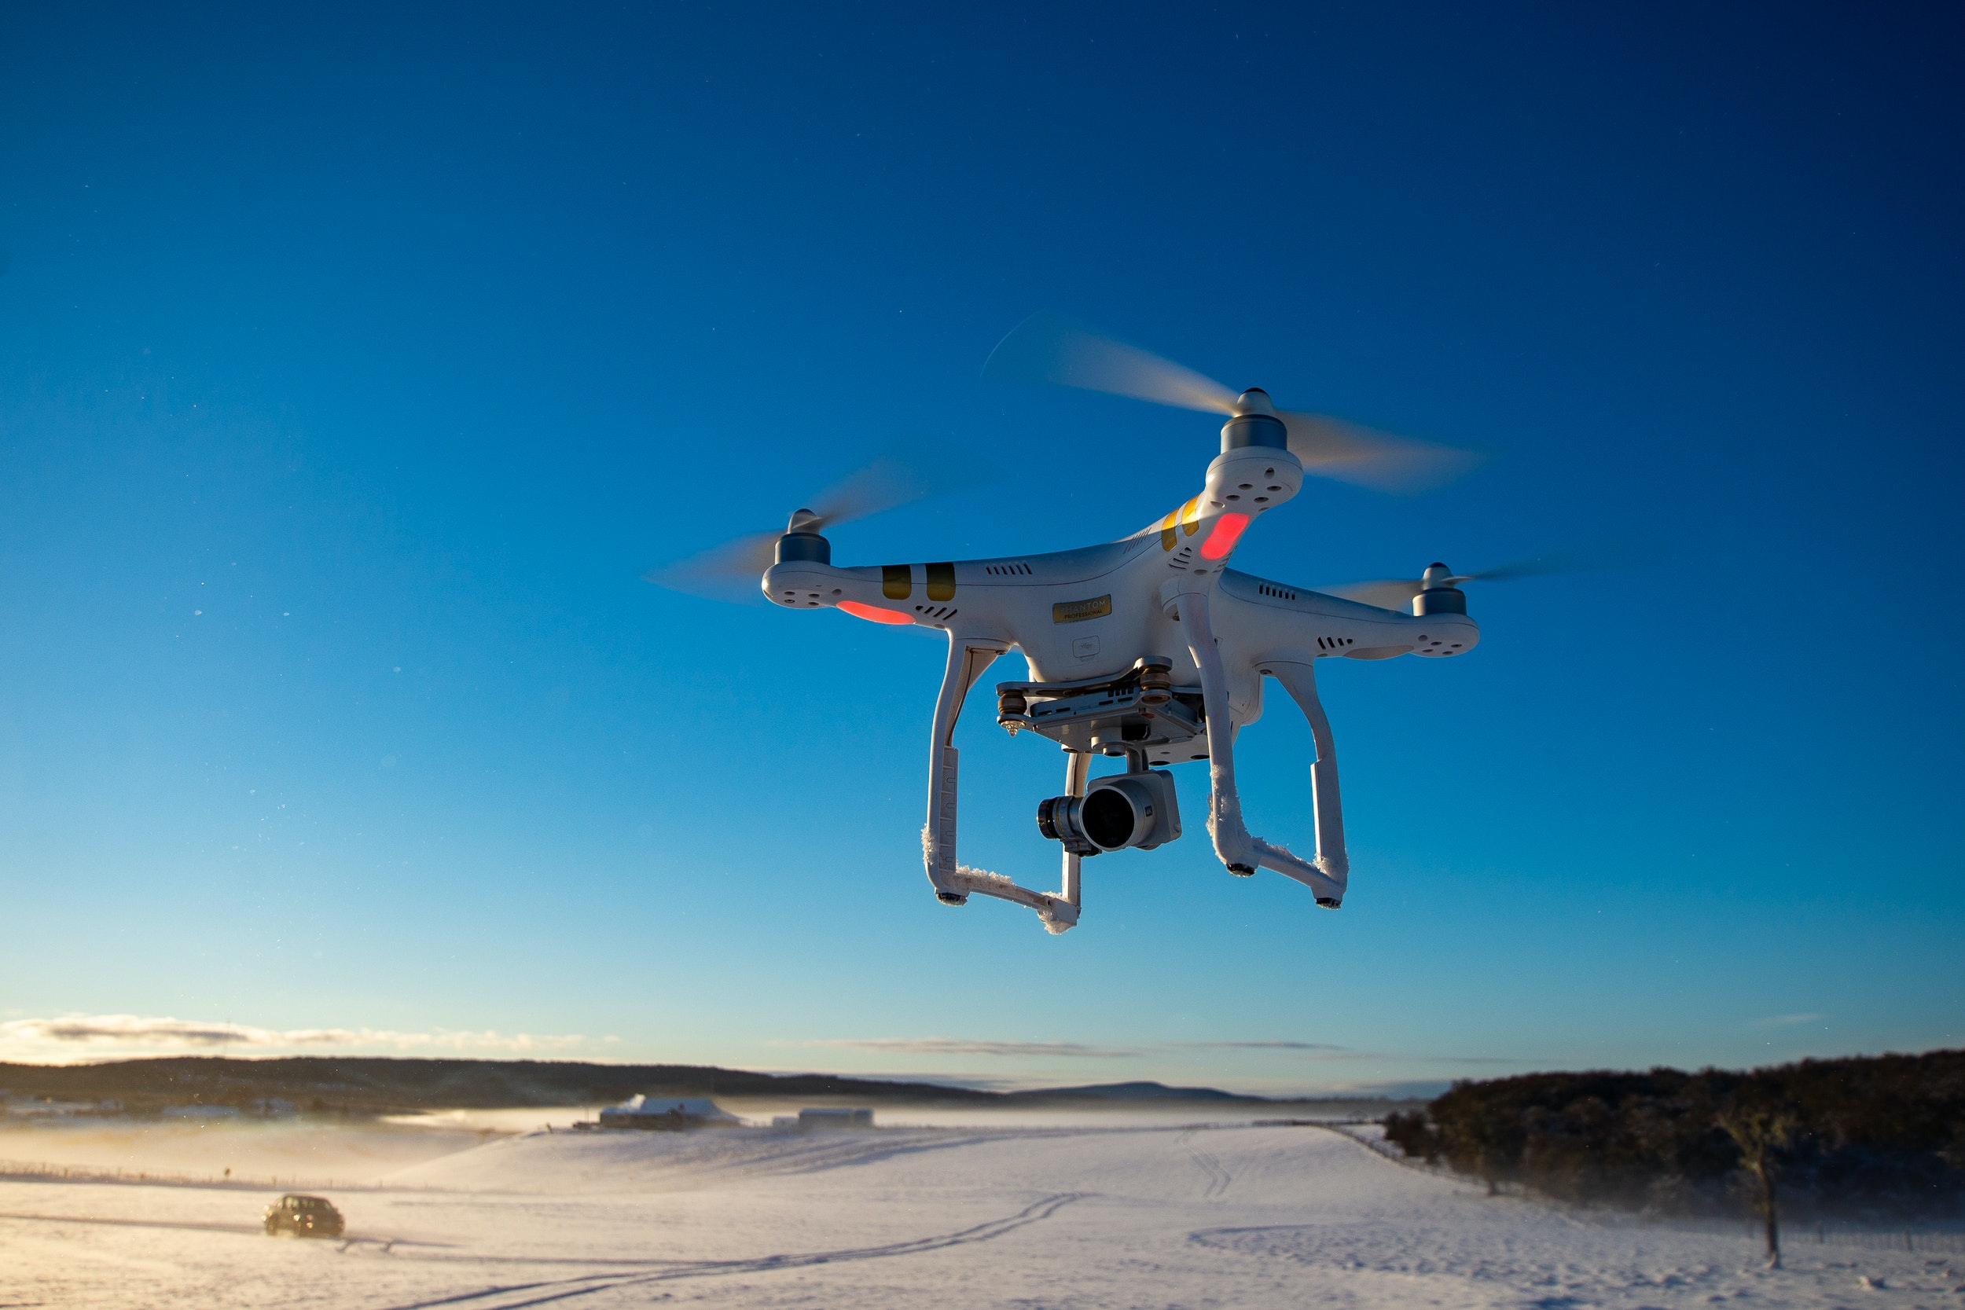
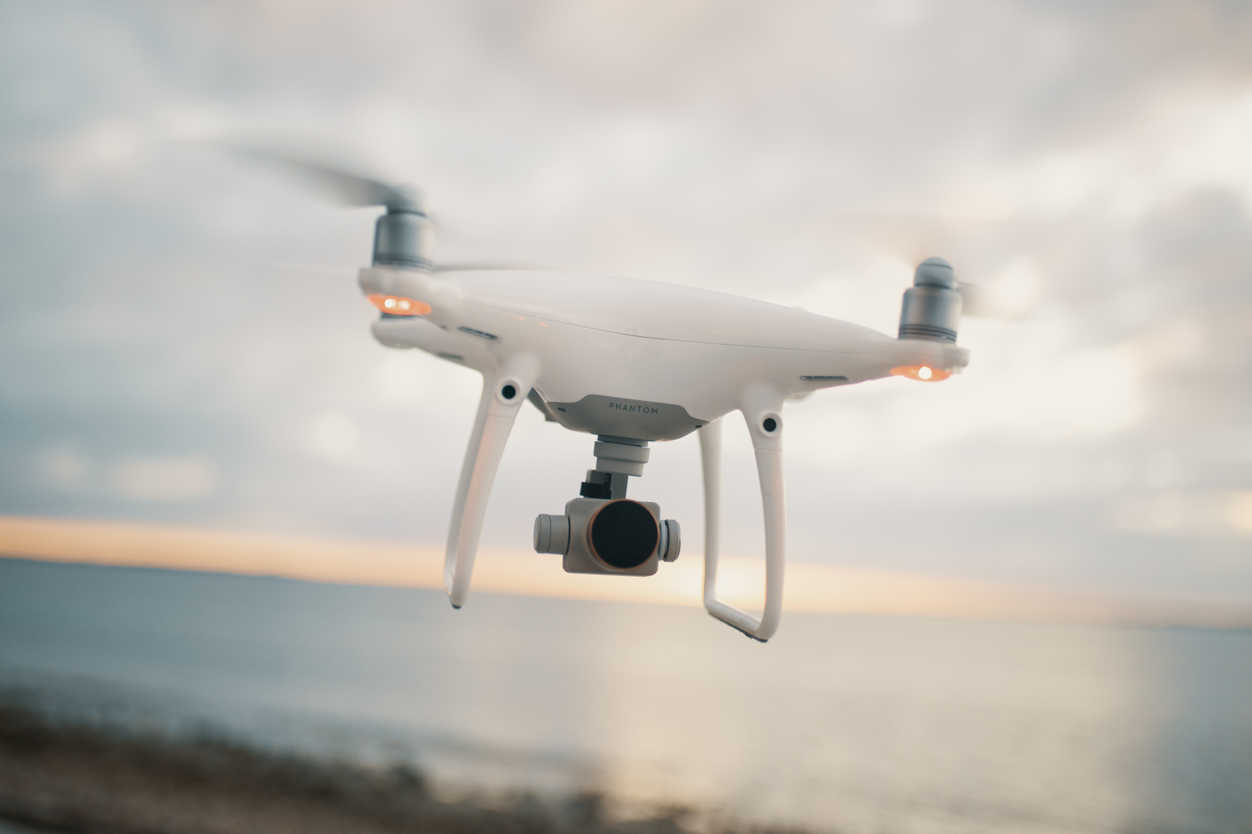
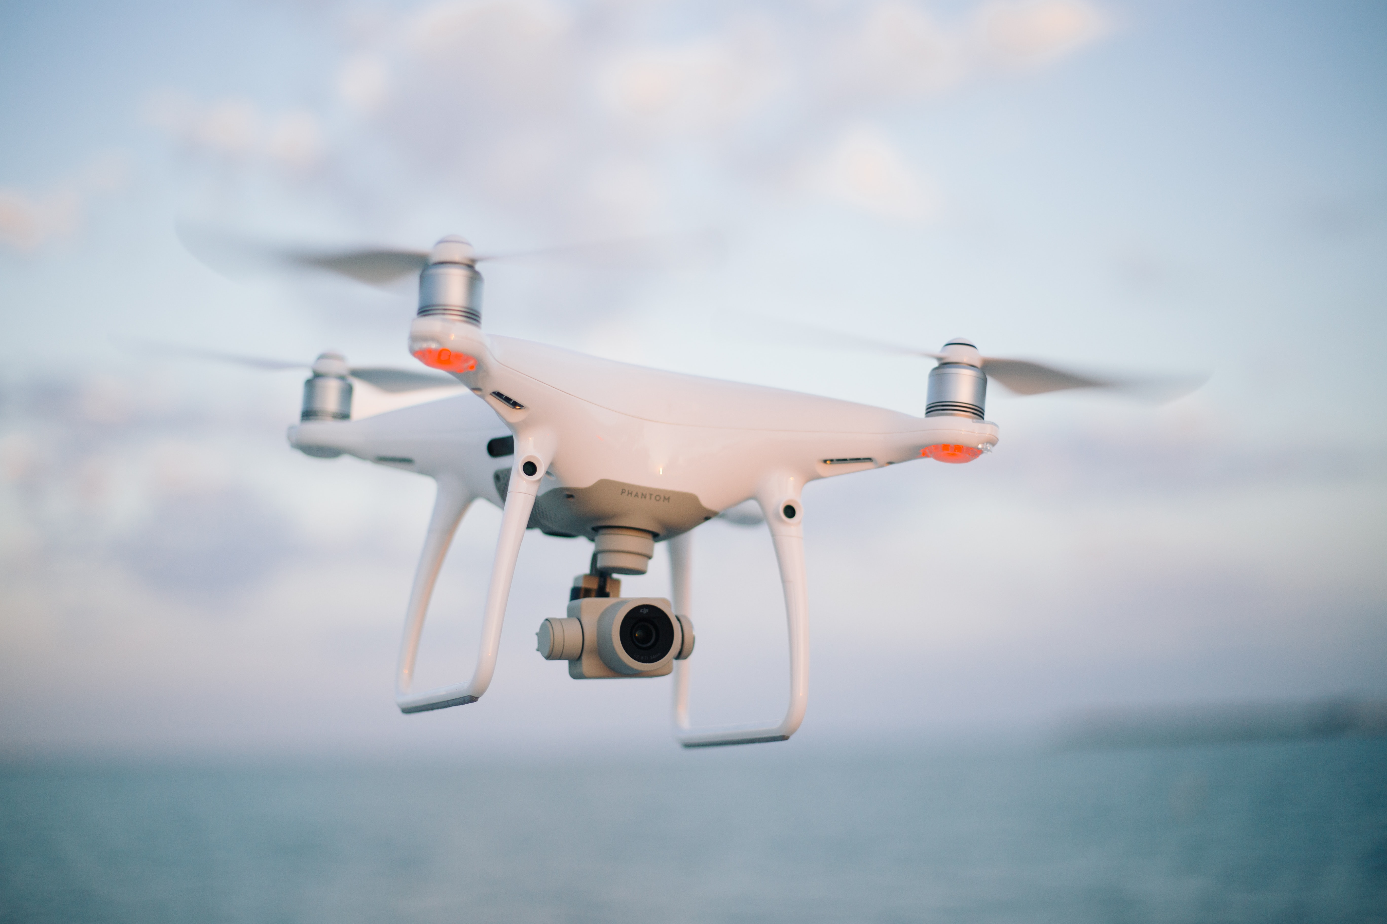
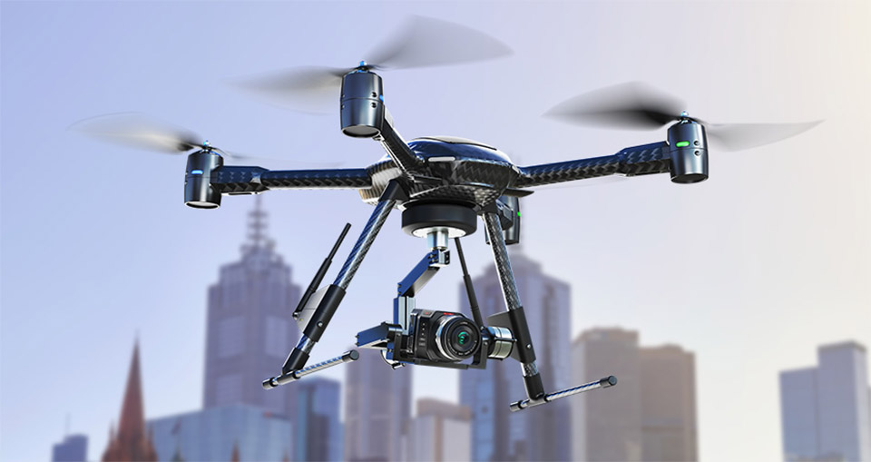
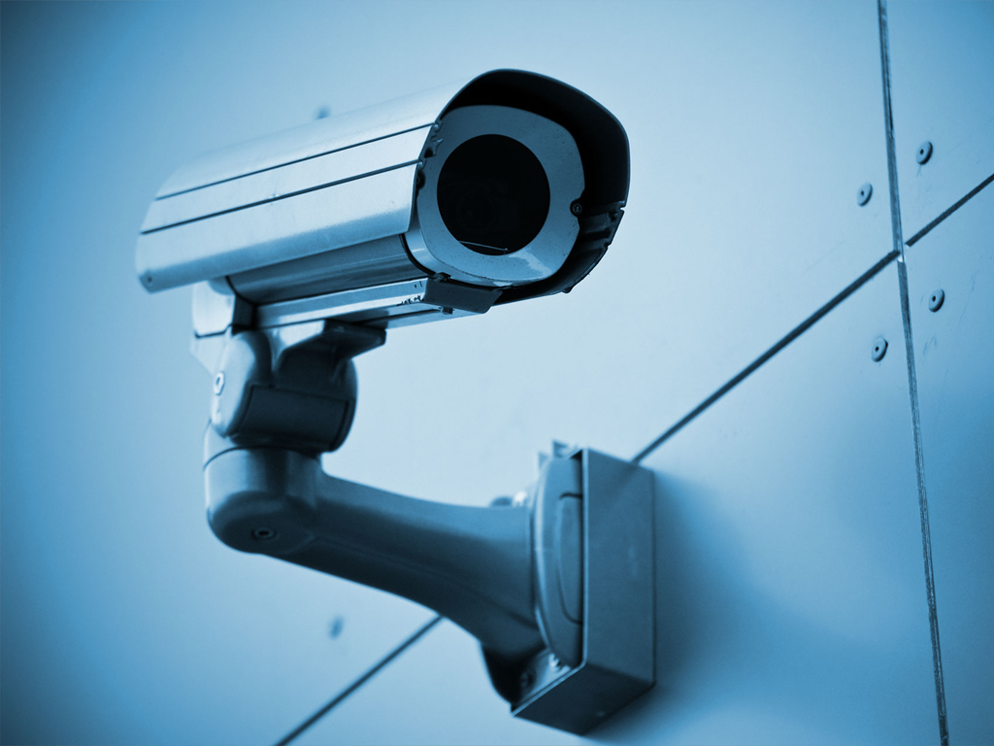
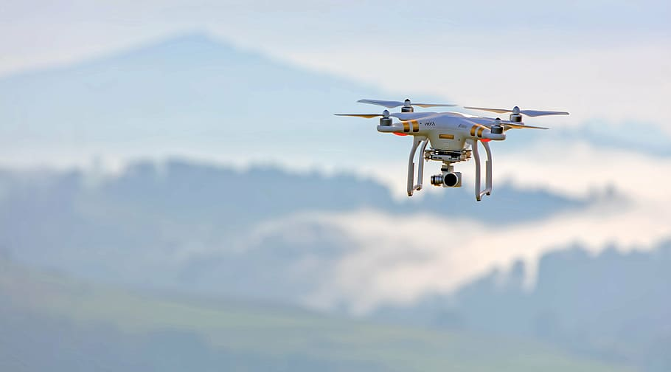
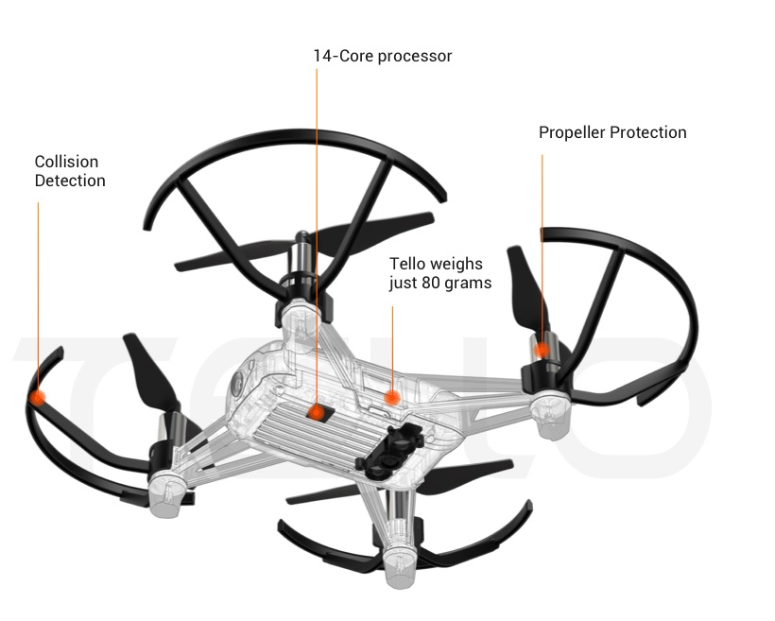
Securo
By: Ria Rao
7-8 Project Programming

Slide 2

What is securo?
A drone specialized in security created by modifying the program of the drone to perform specific tasks

Slide 3
The story behind this project
One day my family and I were travelling, and we got notifications that some of our cameras had fallen off their mounts. This allowed for intruders and many blind spots, so we ultimately lost visual of the area(s).
Then, I started thinking of ways I could combat this problem.

Slide 4
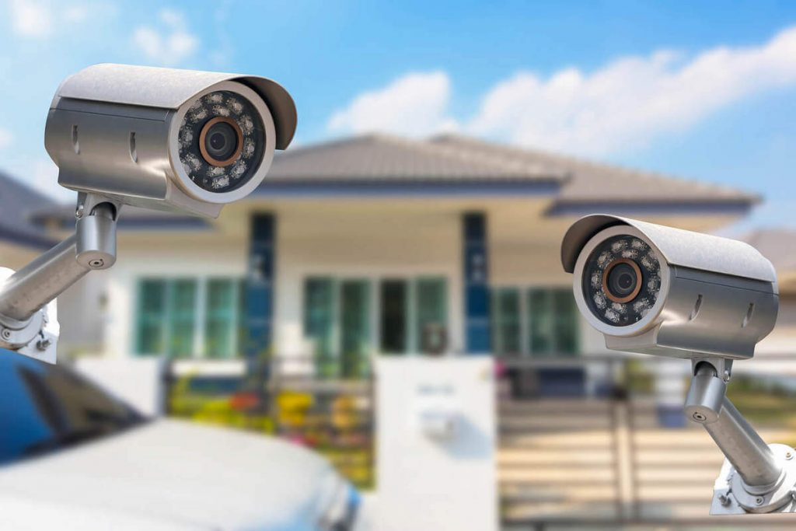
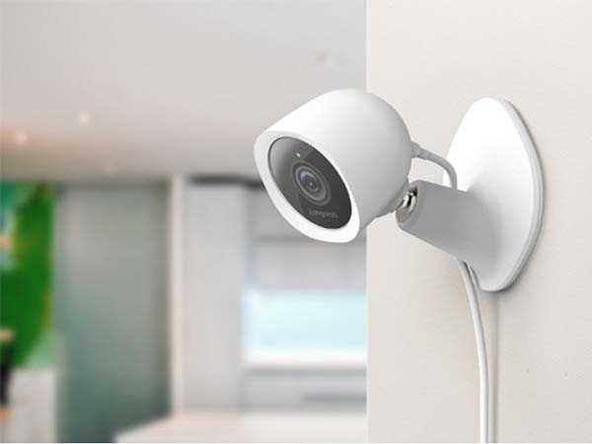

problems with modern cameras
BLINDSPOTS- most cameras have blind spots even if they aren't stationary.
PHYSICAL ISSUES- (because this drone is specialized in outside perimeter surveillance) cameras can be hard to mount on things outside

Slide 5
This is where securo comes in

Slide 6
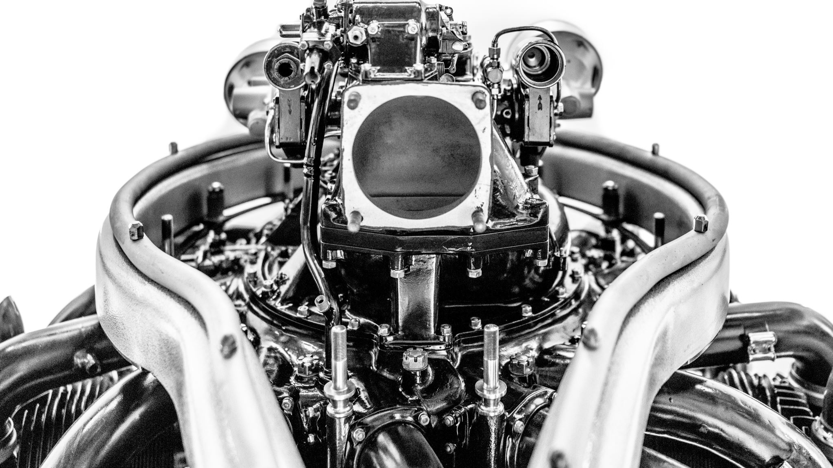
Parts of the drone

Slide 7
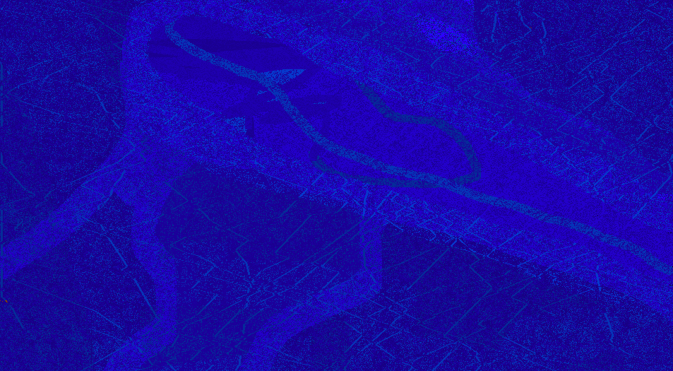
What this modified drone can do
Autonomously follow a defined perimeter
With specific measurements, the drone can fly around the property
Fly different directions, under your control
With a press of a key, the drone can go up, down, forwards, backwards, right, left, and rotate
Take pictures of the surroundings
You can take high-quality pictures of the visuals the drone is in, with a single press.
Send attachments to your email
Any pictures you want to make sure you don't lose can be sent directly to the email of your choice

Slide 8
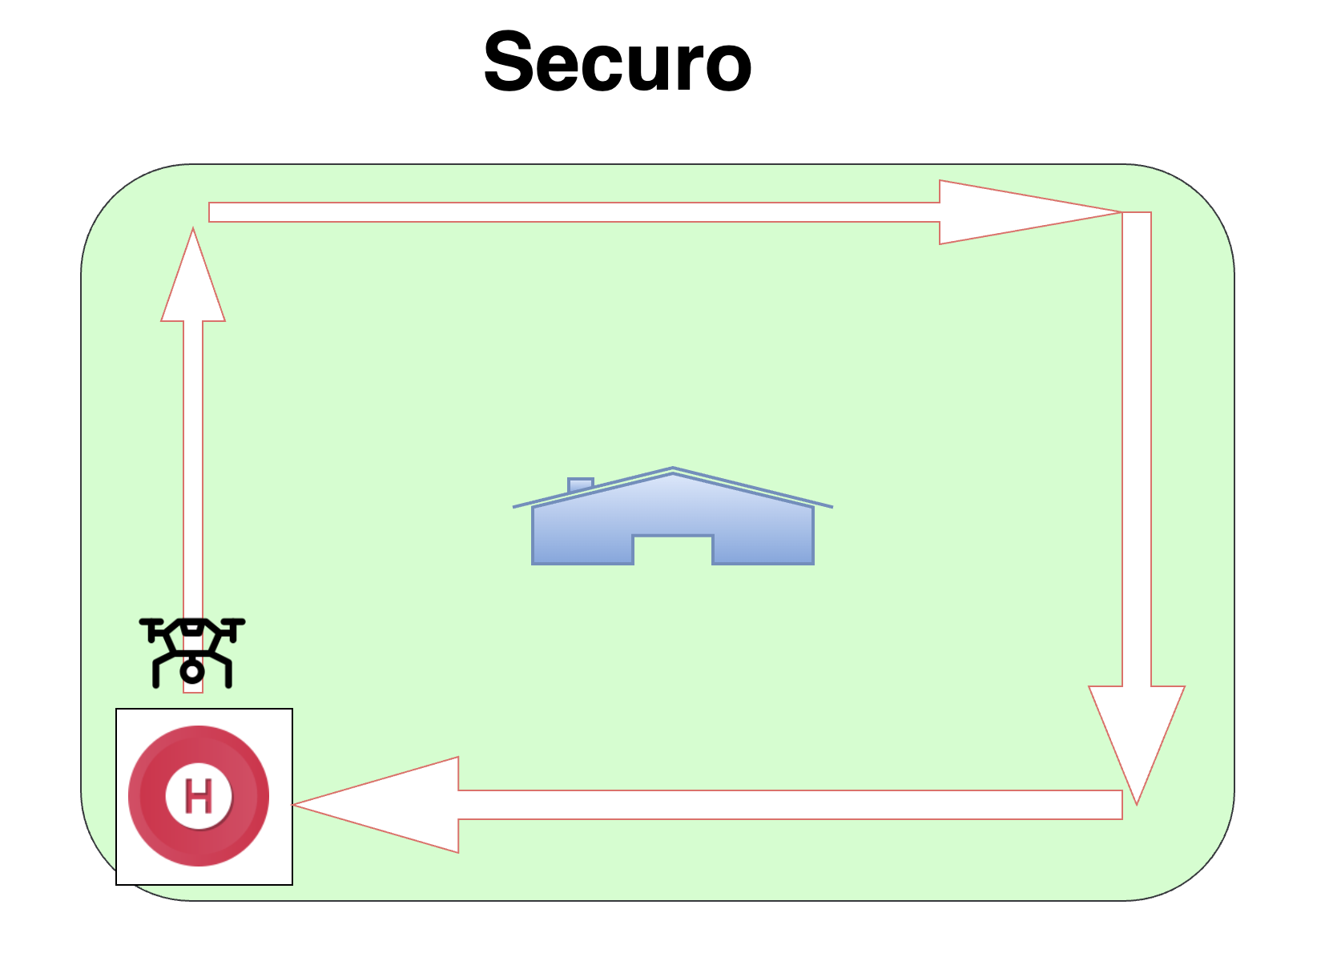
Diagram of the path the drone follows:

Slide 9

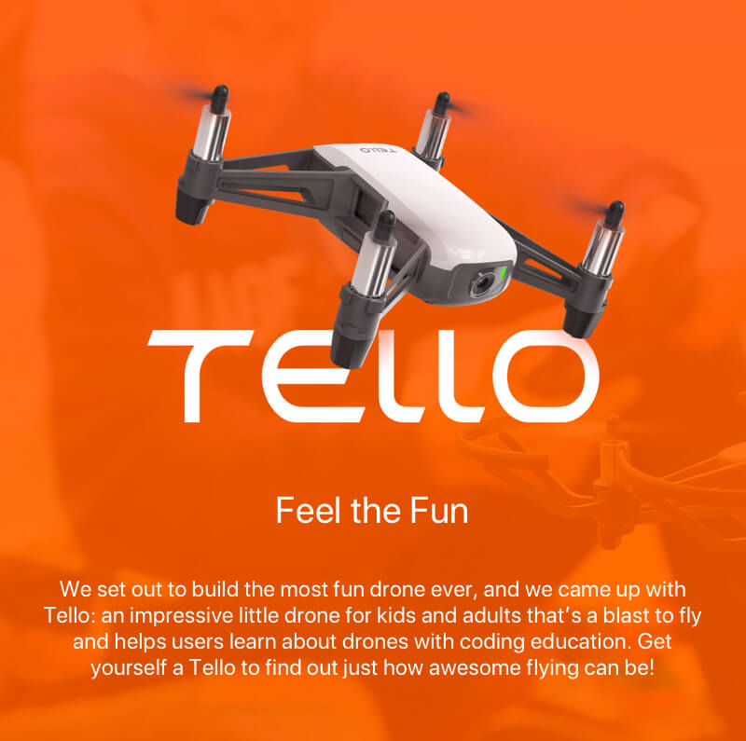
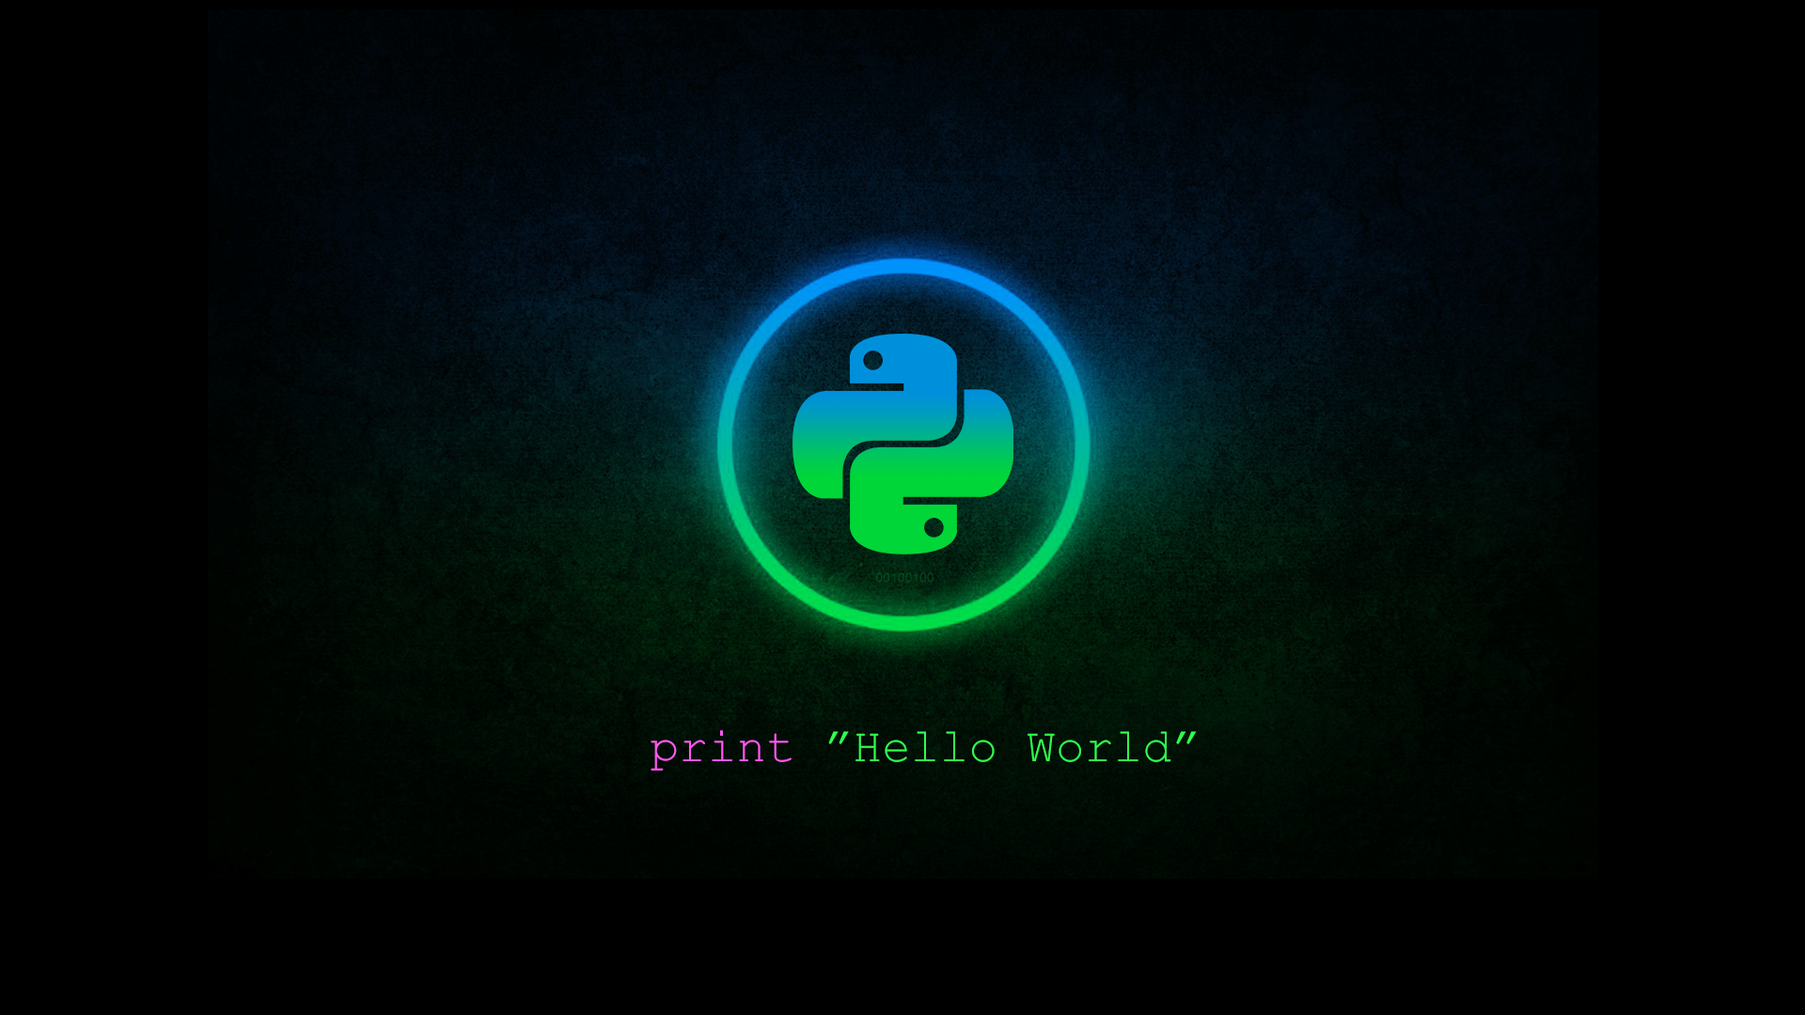


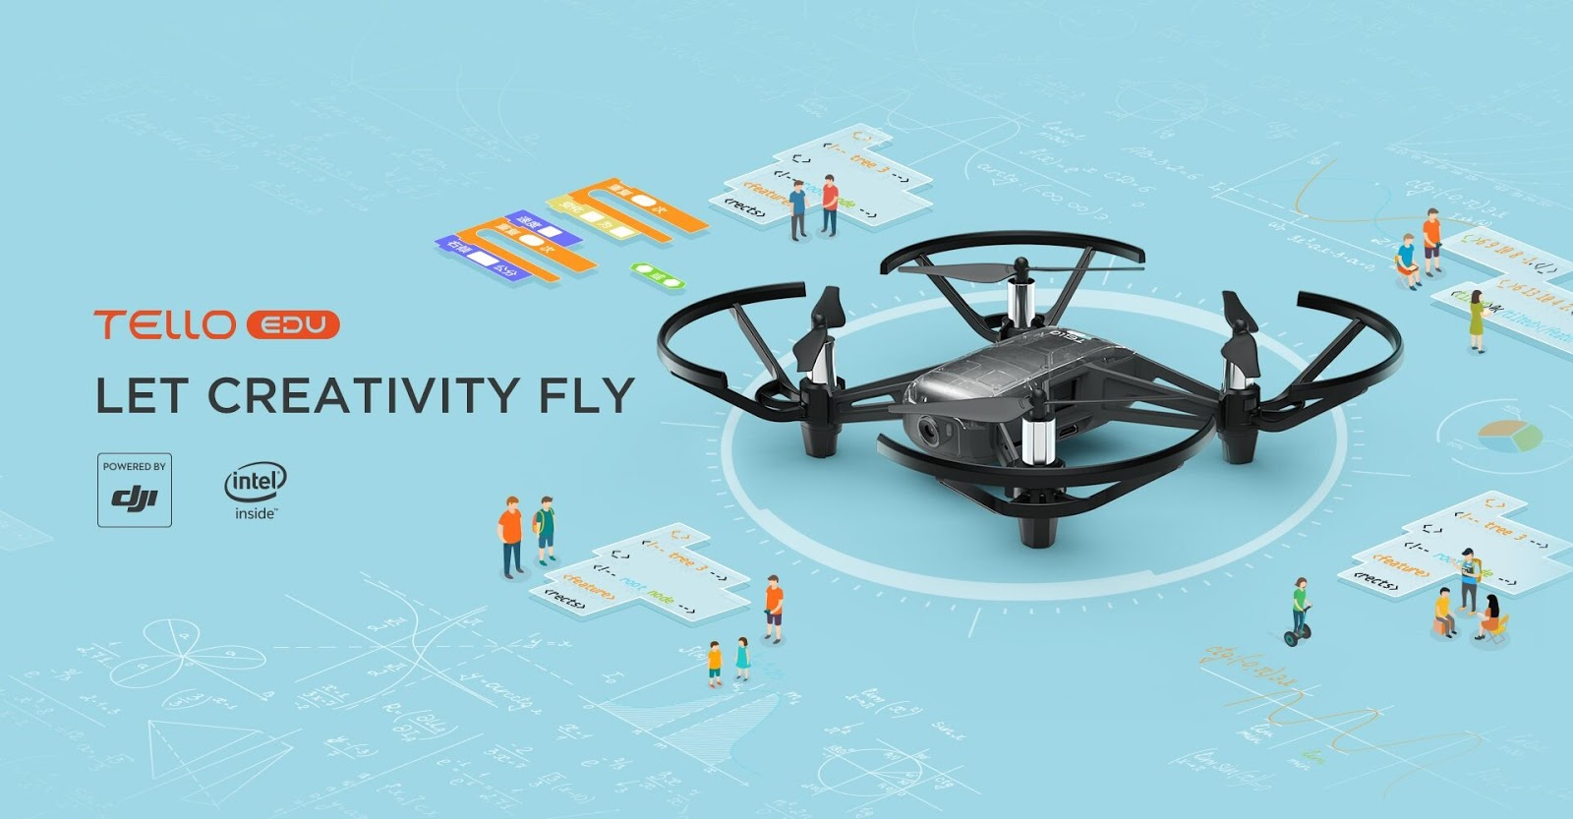
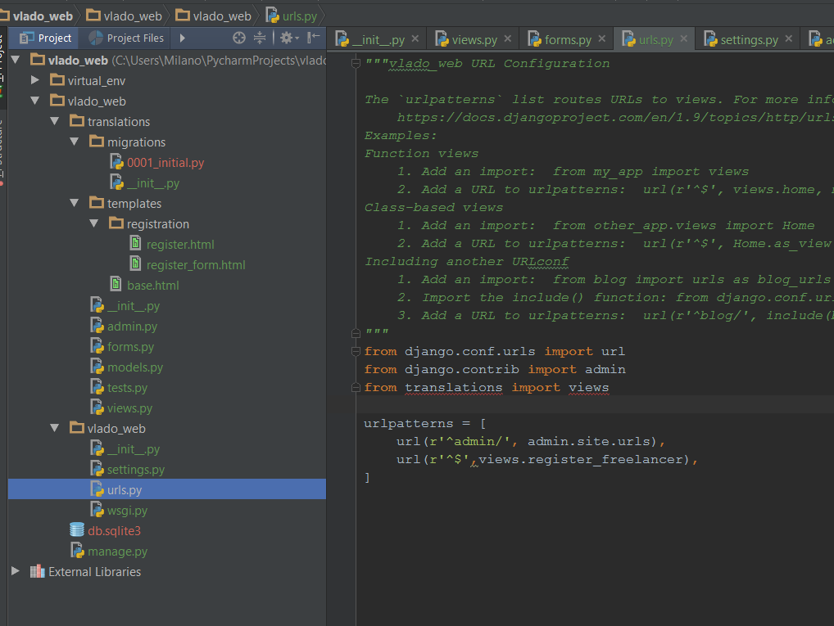
Parts, devices, and programs used
TELLO
The drone used was manufactured by Tello.
This drone supports the languages of Swift, Scratch, and Python
PYTHON
The entire project was programmed using the Python language
PYCHARM
I programmed on PyCharm

Slide 10
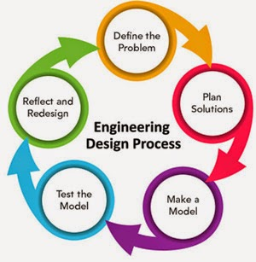
The Process
The problem: modern cameras can't monitor the entire property for criminal activity
Plan: I thought of the best tasks the drone could do to successfully do the job
Create: I made the code to implement on the drone
Test: I ran and tested the modified drone
Reflect & Redesign: Once I found errors, I fixed them and made the drone even better

Slide 11

Time to see the code and the drone!

Slide 12
Glossary
Libraries/Packages used:
Djitellopy: for importing the functions for the Tello drone
OpenCV-python: for python-based computer vison for within the drone
Pygame: for ctrl window while running program
Pip: for managing my python packages and files within PyCharm

Slide 13
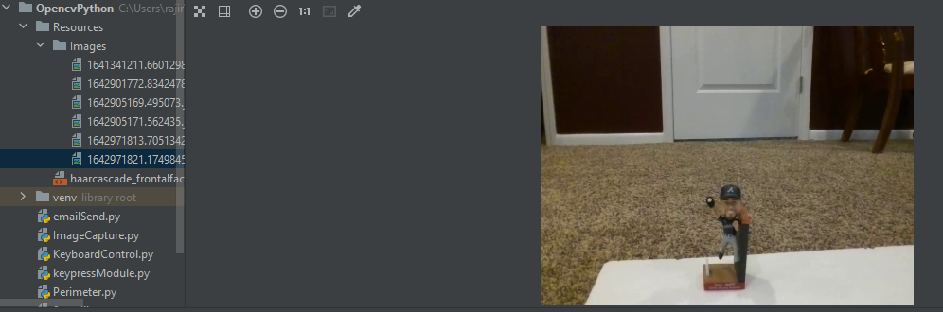
How the pictures look saved::

Slide 14
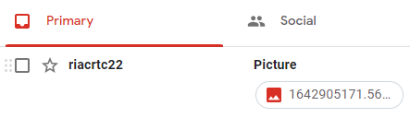
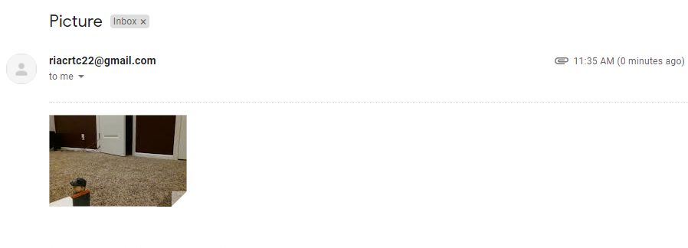
How the pictures send to your email:

Slide 15

In the future, I want to program the sensors of the drone so it can detect objects, people, etc. This way the drone will steer free of danger and make sure not to bump into anything. This will also help advance the tasks the drone can do.
More tasks: motion sensor, object detector, autonomous email system.

Slide 16
Q&A
How long did this take you?
I started this project mid-September and ended this mid-January, so about 3 months
What was the most fun?
I loved seeing how my code was shown with the drone and how it flew based on my program.
What was the hardest part?
The syntax errors often discouraged me because it sometimes took me a few weeks to solve. To be specific, the email and image capture was hardest. Also, the battery life of the Tello drone.
The easiest part?
The autonomous perimeter flying because it was very easy to understand, and had the least errors

Slide 17
Resources/References
Github link: https://github.com/ria12rao/securo
API References: https://djitellopy.readthedocs.io/en/latest/tello/#djitellopy.tello.Tello
Intro to programming Tello drone: https://www.youtube.com/watch?v=uaXbfDFAp-0

Slide 18
Thank you!
This Photo by Unknown author is licensed under CC BY-SA-NC.

